Slide 1

CANADA NEEDS PAs

Slide 2


What is a Physician Assistant
Advanced health care practitioner trained to deliver delegated medical services and comprehensive patient care
Practice under supervising physicians with negotiated autonomy, exercising clinical judgment within established medical directives
Independently insured professionals (carry their own liability coverage)
Collaborate within interdisciplinary teams to enhance care delivery and patient access
Employed across diverse healthcare settings throughout Canada

Slide 3

Growth of PAs in Canadian Health Care System
1984 Canadian Armed Forces (CAF) established profession to provide full spectrum medical care.
​
1999 Manitoba regulates clinical assistants. In 2009 title amended to Physician Assistant.
​
2006 Ontario pilot project allowing PAs to practice as unregulated health professionals. Regulation enacted April 2025. Commitment to add training spots in 2023 (52) and again in 2026 (150).
​
2009 New Brunswick amends Medical Act to include PAs in health care model. Legislation amended in 2025 to allow practice outside hospitals and purchases training spots in Dalhousie program.
​
2010 Alberta bylaw passed allowing PAs to operate under responsibility of a regulated member. Demonstration project in 2013, regulation enacted by CPSA in 2021 and U of C program ​in 2024.
​
2019 Nova Scotia introduces PAs via pilot in orthopedic surgery. Followed by emergency departments and primary care. Dalhousie starts PA program and regulation is enacted by CPSNS in 2024.

Slide 4

Growth of PAs continued
2023 Saskatchewan makes legislative change to allow PAs to practice, regulates PAs under the CPSS and announces USask PA program to launch in 2025.
Newfoundland and Labrador invests in PA pilot. Legislation to regulate PAs in 2024.
Prince Edward Island makes legislative change to allow PAs to practice. Regulation enacted with Medicine Act amended in 2024. Province purchases training spots in Dalhousie program in 2025.
British Columbia announces plans to introduce PAs in ERs. Bylaws come into effect in 2024. First PAs start working in BC in 2025.
Quebec Minister of Health announces pilot project to introduce PAs in Northern Quebec with PAs starting in 2024.
Yukon unanimously passes motion to allow PAs to practice in the territory.
PAs can now practice coast to coast!

Slide 5







Education
Seven university level academic programs in Canada since 2008:
Programs highly competitive, 3000+ applicants per year for a combined total of 224 seats (soon to be 353)
Intensive PA Program:
  Aligned with medical model to lay foundation for collaborative working relationship with physicians.
    Accreditation Canada EQual accredited.
    Extends over 24 months.
    Didactic training plus 48 weeks (over 2,000 hours) of Physician-directed rotations.
    Objective Structured Clinical Exam (OSCE) administered by program to assess student's clinical skills and knowledge.
      Series of stations focusing on different aspect of clinical practice

Slide 6
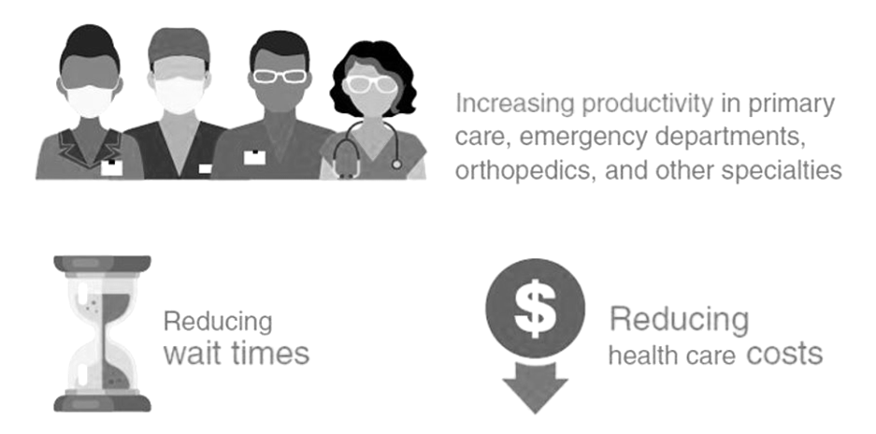
Key Messages
PAs Help Reduce Wait Times
  Adding PAs to Primary Care teams means that more patients can be attached and more same-day appointments can be offered​.
  In Emergency Rooms, PAs can help bring down key benchmarks, limiting the number of people leaving without being seen. PAs can also help keep Emergency Departments open.

Slide 7


Key Messages Continued
PAs Help Improve Access to Care in Rural and Remote Communities
Rural communities are hit hard by doctor shortages and need more health care providers. Adding multiple PAs, under the supervision of just one physician, can have an immediate impact.
PAs have been used to keep emergency departments open when no physician remains in the community.
In a rural practice, PAs can:
Provide home, nursing home, and hospital visits.
Provide direct emergency and urgent care services.
Perform office procedures.
Provide after-hours consults and work on-call.
Improve the continuity of care, especially for patients with chronic conditions.

Slide 8

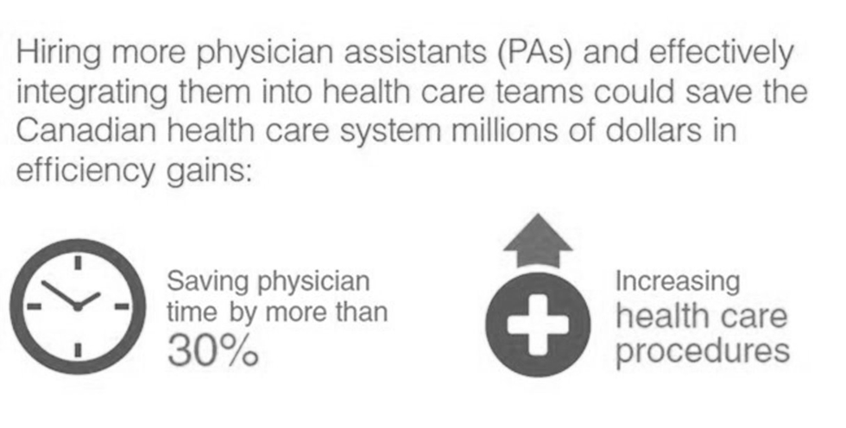
Key Messages Continued
PAs Help Gain Efficiencies and Save Money
The Conference Board of Canada reports that if PAs could relieve more than 30 per cent of physicians' time in all practice area, this could represent $620 million in cost savings for the health care system.

Slide 9


Next Steps
Canada Needs More PAs to Help Address Challenges in the Healthcare System
Expand PA education and clinical training opportunities
Provide fair compensation to recruit and retain skilled workforce
  See CAPA Compensation Report
Develop funding model to ensure sustainability of the profession
  See Conference Board of Canada Report, Unlocking Potential: Exploring Physician Assistant Funding Models and Impact Potential for Three Practice Settings

Slide 10

Thank you…
Questions?

