Slide 1
CANADA NEEDS PAs

Slide 2
What is a Physician Assistant
Advanced health care professional that work as Physician Extenders addressing important challenges in health care system.​
PAs work under the scope of a supervising physician(s) to provide care to patients.
Negotiated autonomy; make decisions and take actions at discretion of supervising physician. ​
Work collaboratively with health professionals in teams to deliver enhanced level of care for patients.
PAs can work in any clinical setting and are presently employed in all aspects of healthcare across Canada

Slide 3
Growth of PAs in Canadian Health Care System
1984 Canadian Armed Forces (CAF) established profession to provide full spectrum medical care.
​
1999 Manitoba regulates clinical assistants. In 2009 title amended to Physician Assistant.
​
2006 Pilot project in Ontario allowing PAs to practice as unregulated health professionals. Regulation enacted April 2025.
​
2009 New Brunswick amends Medical Act to include PAs in health care model. 2025 legislation amended to allow practice outside hospitals.
​
2010 Bylaw passed in Alberta allowing PAs to operate under responsibility of a regulated member. Demonstration project with 13 PAs in 2013. Regulation enacted in 2021​.
​
2019 Nova Scotia introduces PAs via pilot in orthopedic surgery. In 2023 government invests to add PAs in primary care and instructs CPSNS to regulate profession. Regulation enacted in 2024.
2023 Saskatchewan invests in PAs and introduces legislative change to allow PAs to practice.
Newfoundland and Labrador invests in PA pilot. Legislation to regulate PAs in 2024.
Prince Edward Island makes legislative change to allow PAs to practice. Regulation enacted.
BC announces plans to introduce PAs in ERs. Bylaws come into effect in 2024.
Quebec Minister of Health announces pilot project to introduce PAs in Northern Quebec with PAs starting in 2024.
2025 First PAs start working in BC, University of Saskatchewan MPAS Program starts in September.

Slide 4
Education
Six university level academic programs in Canada since 2008:
Programs highly competitive, 2500+ applicants per year for a combined total of 203 seats.
Intensive PA Program:
Aligned with medical model to lay foundation for collaborative working relationship with physicians.
Accreditation Canada EQual accredited.
Extends over 24 months.
Didactic training plus 48 weeks (over 2,000 hours) of Physician-directed rotations.
Objective Structured Clinical Exam (OSCE) administered by program to assess student's clinical skills and knowledge.
Series of stations focusing on different aspect of clinical practice

Slide 5
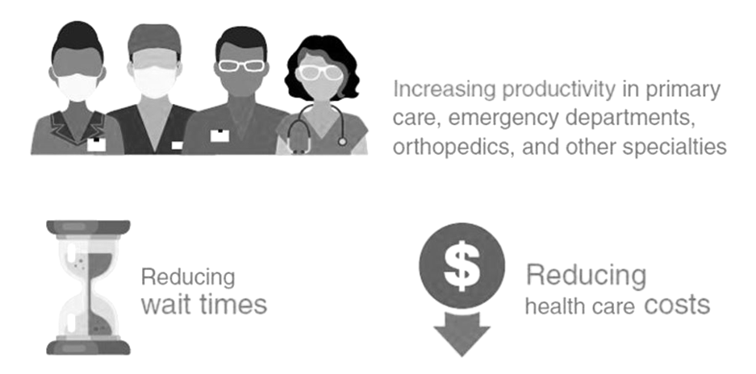
Key Messages
PAs Help Reduce Wait Times
Adding PAs to Primary Care teams means that more patients can be attached and more same-day appointments can be offered​.
In Emergency Rooms, PAs can help bring down key benchmarks, limiting the number of people leaving without being seen. PAs can also help keep Emergency Departments open.

Slide 6
Key Messages Continued
PAs Help Improve Access to Care in Rural and Remote Communities
Rural communities are hit hard by doctor shortages and need more health care providers. Adding multiple PAs, under the supervision of just one physician, can have an immediate impact.
PAs have been used to keep emergency departments open when no physician remains in the community.
In a rural practice, PAs can:
Provide home, nursing home, and hospital visits.
Provide direct emergency and urgent care services.
Perform office procedures.
Provide after-hours consults and work on-call.
Improve the continuity of care, especially for patients with chronic conditions.

Slide 7
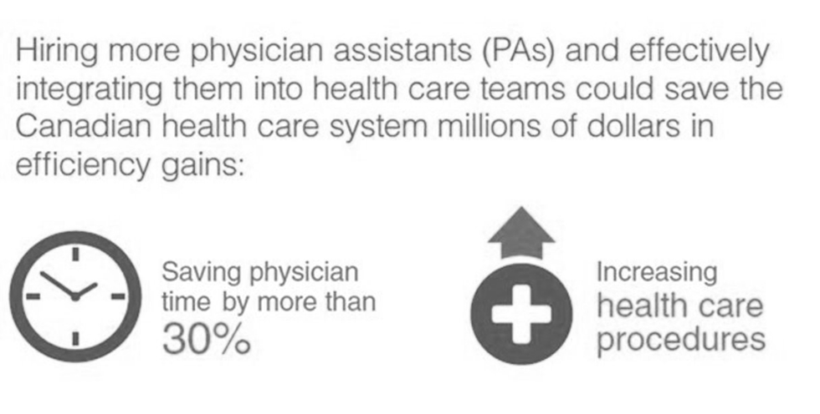
Key Messages Continued
PAs Help Gain Efficiencies and Save Money
The Conference Board of Canada reports that if PAs could relieve more than 30 per cent of physicians' time in all practice area, this could represent $620 million in cost savings for the health care system.

Slide 8
Next Steps
Canada Needs More PAs to Help Address Challenges in the Healthcare System
Invest in more training spots and develop new programs
Provide fair compensation to recruit and retain skilled workforce
See CAPA Compensation Report
Develop funding model to ensure sustainability of the profession
See Conference Board of Canada Report, Unlocking Potential: Exploring Physician Assistant Funding Models and Impact Potential for Three Practice Settings

Slide 9
Thank you…
Questions?

